Slide 1





Mobile Voice Communications Development in 2008-2023
August, 2025

Slide 2
I . Data Pre-Processing

Slide 3
Data Pre-Processing Overview
Data was obtained in *.zip from the public website of International Telecommunications Union, https://datahub.itu.int/ except for summary table with country classification - https://datahub.itu.int/dashboards/idi/?e=ISR&y=2025
Zip files are saved and unpacked locally because downloading them from the website is inefficient and slower Data includes 3 dataframes – mobile voice indicators, population and subscribers and country income and regional classification
The dataframes were merged, data for 2003-2008 was deleted due to data unavailability for some indicators, countries with more that one zero except the last year were dropped. The remaining data for 137 countries in incomplete but is quite representative for the objective
Data for 2004 is mainly missing, so further analysis shows comparable data analysis for 2008-2023
New indicators were calculated further in ITU_Utilities – 1. Market Size (ARPU * Subscribers *12) and 2. Penetration Rate (Subscribers / Population)
ITU_Utilities also calculates means for country aggregates classified by income, region and World ARPU and Penetration Rates and also includes the totals for the other country-aggregate indicators
The resulting dataframe for further manipulations in ITU_Main, ITU_Utilities and Create_Charts files is opened in the file ‘ITU_Mobile_Telecoms ‘, was called ‘formatted_for_sbrn.xlsx’ The analysis on the following slides is based only on mobile voice data, for shortcut the missing conclusions are provided by the author, because the focus of this is python-based data processing capacity rather than full-scale financial analysis
2

Slide 4
II. Data Analysis

Slide 5
Applicable Areas
Market research for commerce and foreign trade
Economic development programs analysis (ITU is part of UN) for development banks like World Bank, IMF etc.
Securities investment research for upside potential
4

Slide 6
Global Mobile Voice Data Market Overview
The golden era of mobile voice market was disrupted by 2012 shifting to data and messengers from 2013 Despite the common expectation the growth of subscribers leads to the decline of mobile voice market, however, it means that revenues shift to data and media market segments
Part of revenues was lost to social media and mobile apps driving EBITDA margins from the peaks of 52%-58% (higher than FAANNG – Facebook, Amazon, Apple, Netflix, Nvidia, Google) down to 32%-38% range
Mobile operators are seeking for new content- and service- based growth models to avoid becoming a data traffic pipeline with varying but limited success (from negative to less than 10% EBITDA margin effect)
Mobile penetration rates exceeded 100% in most countries due to business voice communications, where businesses and employees have additional SIM cards or eSIM accounts
Due to mobile number portability people change operators more often than before and often keep promotional SIM cards
Less developed emerging markets started the shift towards data before the market saturation due to apparent cost savings
For the future of mobile communications market data, media and value chain segments have to be taken into the analysis but they were not in the scope and dataframes of this presentation
Penetration growth over 100% due to the surge of data services and IOT is a known fact but this presentation is based on mobile voice data to demonstrate Python application skills and does not factor data services and other trends into account
4

Slide 7
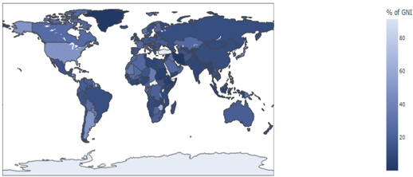
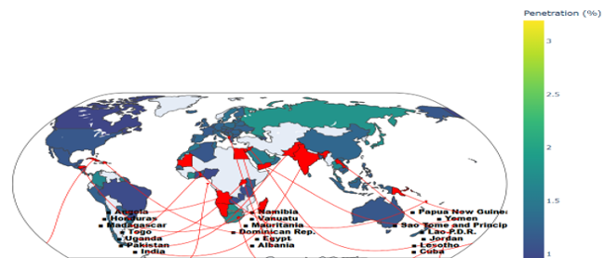
Investment Potential
Despite the market maturity mobile communications market provides strong investment and development potential in some emerging markets
By 2023 the cost of mobile and internet access has become acceptable globally
The remaining digital divide still provides opportunities for strategic investment
Funding from development organizations, private investments and government support improve infrastructure, expand coverage, and accelerate the digitalization
Increasing access to mobile communications provides opportunities for residents to study, work, business, and receipt of services
Communications provide multiplication effect for economic growth for both individuals and countries
Market capitalization growth potential still provides strong investment potential in some less developed parts of the world, at least lowest 20 countries by penetration
Cost of Mobile Access (% GNI), 2023
Lowest 20 Mobile Penetration Countries, 2023
Source: ITU
5

Slide 8
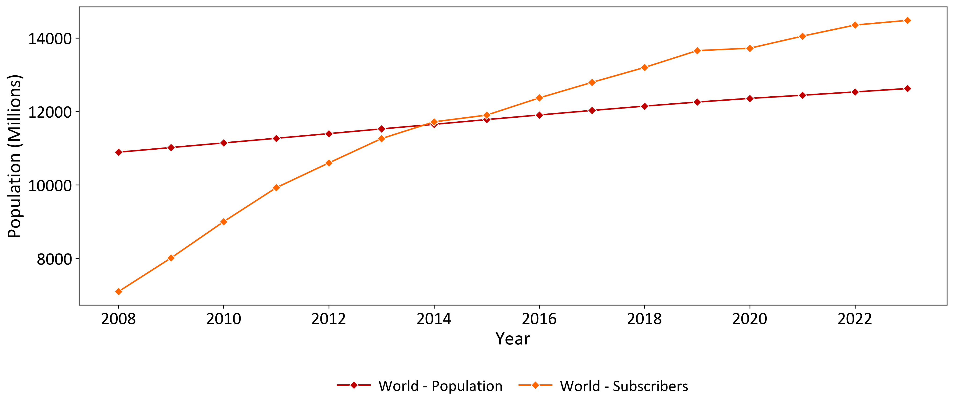
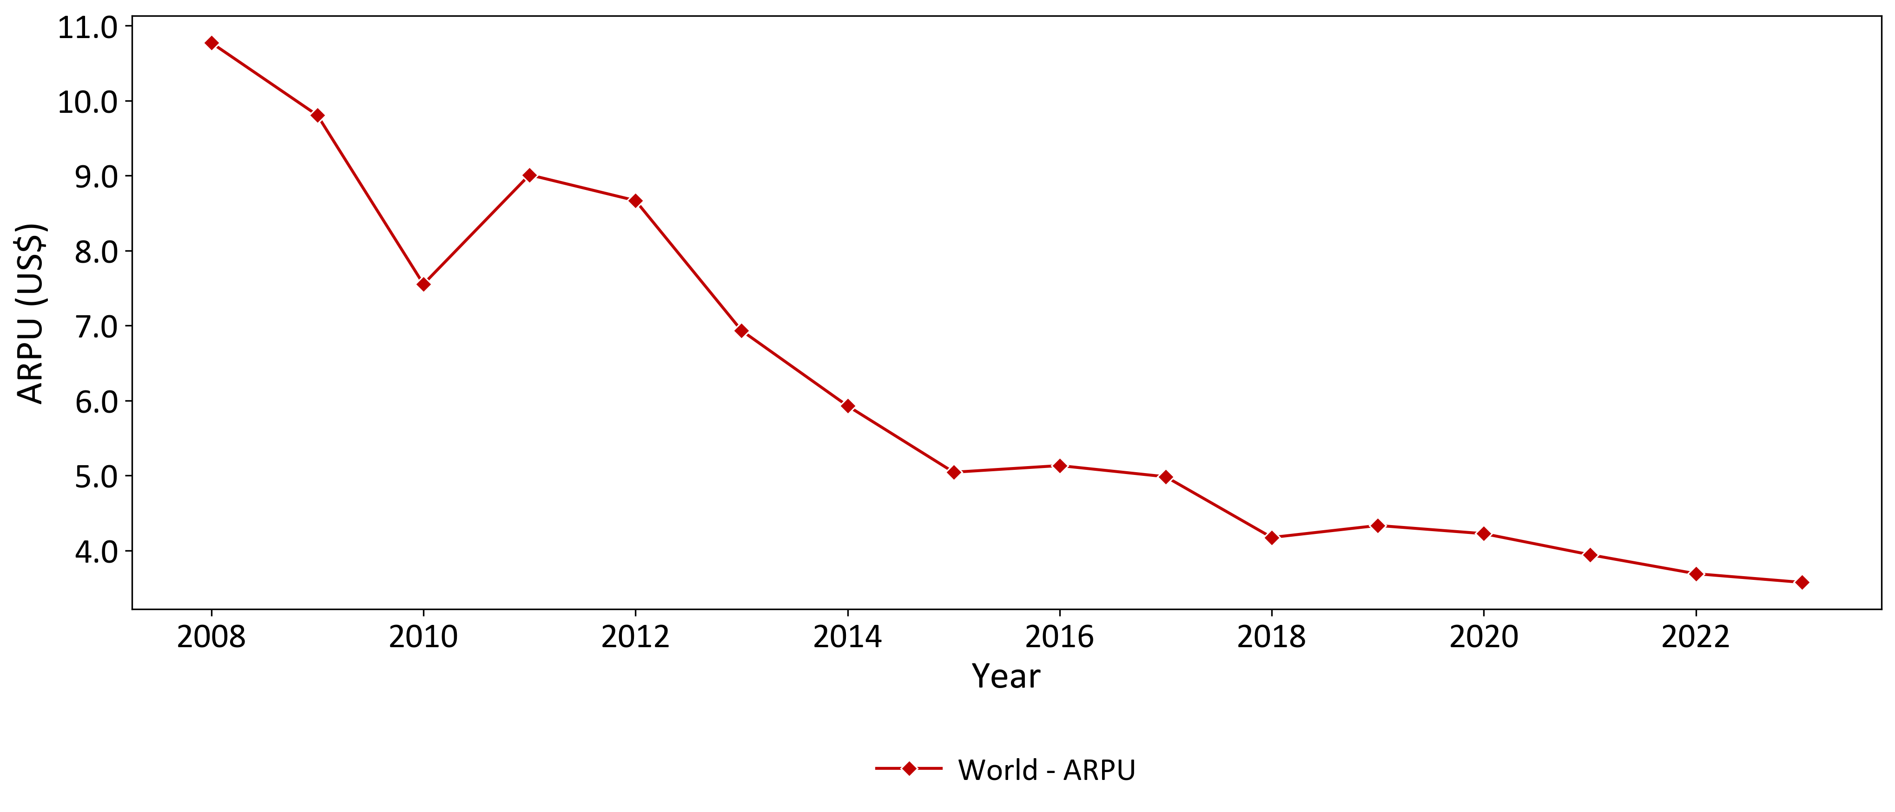
Mobile Telecommunications Market Overview
Mobile voice data market was the fastest growing industry in the world ever
By 2014 the global penetration rate exceeded the global population due to several numbers for voice data. Other factors, not related to voice services, also include wireless data modems, data only services and Internet of things (IOT) with individual additional SIM cards
Average Global ARPU enabled the market growth driven both by the economies scale, technological improvements, competition, pay-as-you-go tariffs, transition from voice to lower cost data traffic in voice over LTE/Internet (VOLTE/VOIP) in mobile networks and data in messengers
Those changes were different for individual countries and regions
Global Population and Subscribers Development
Global Mobile Voice Average Revenue per User (ARPU) Development
Source: ITU
5

Slide 9
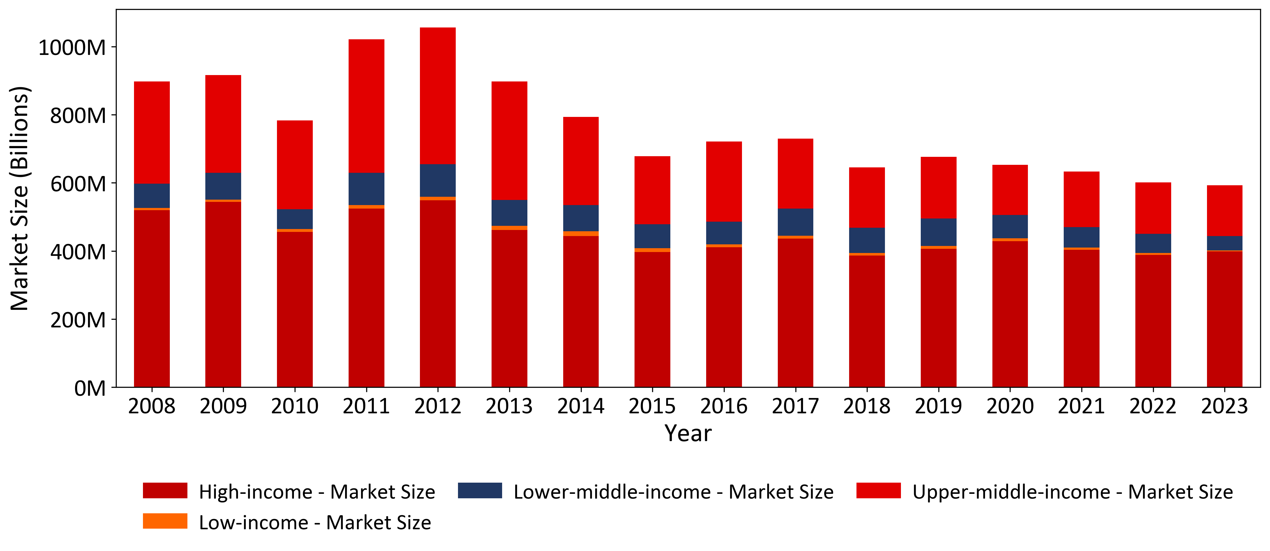
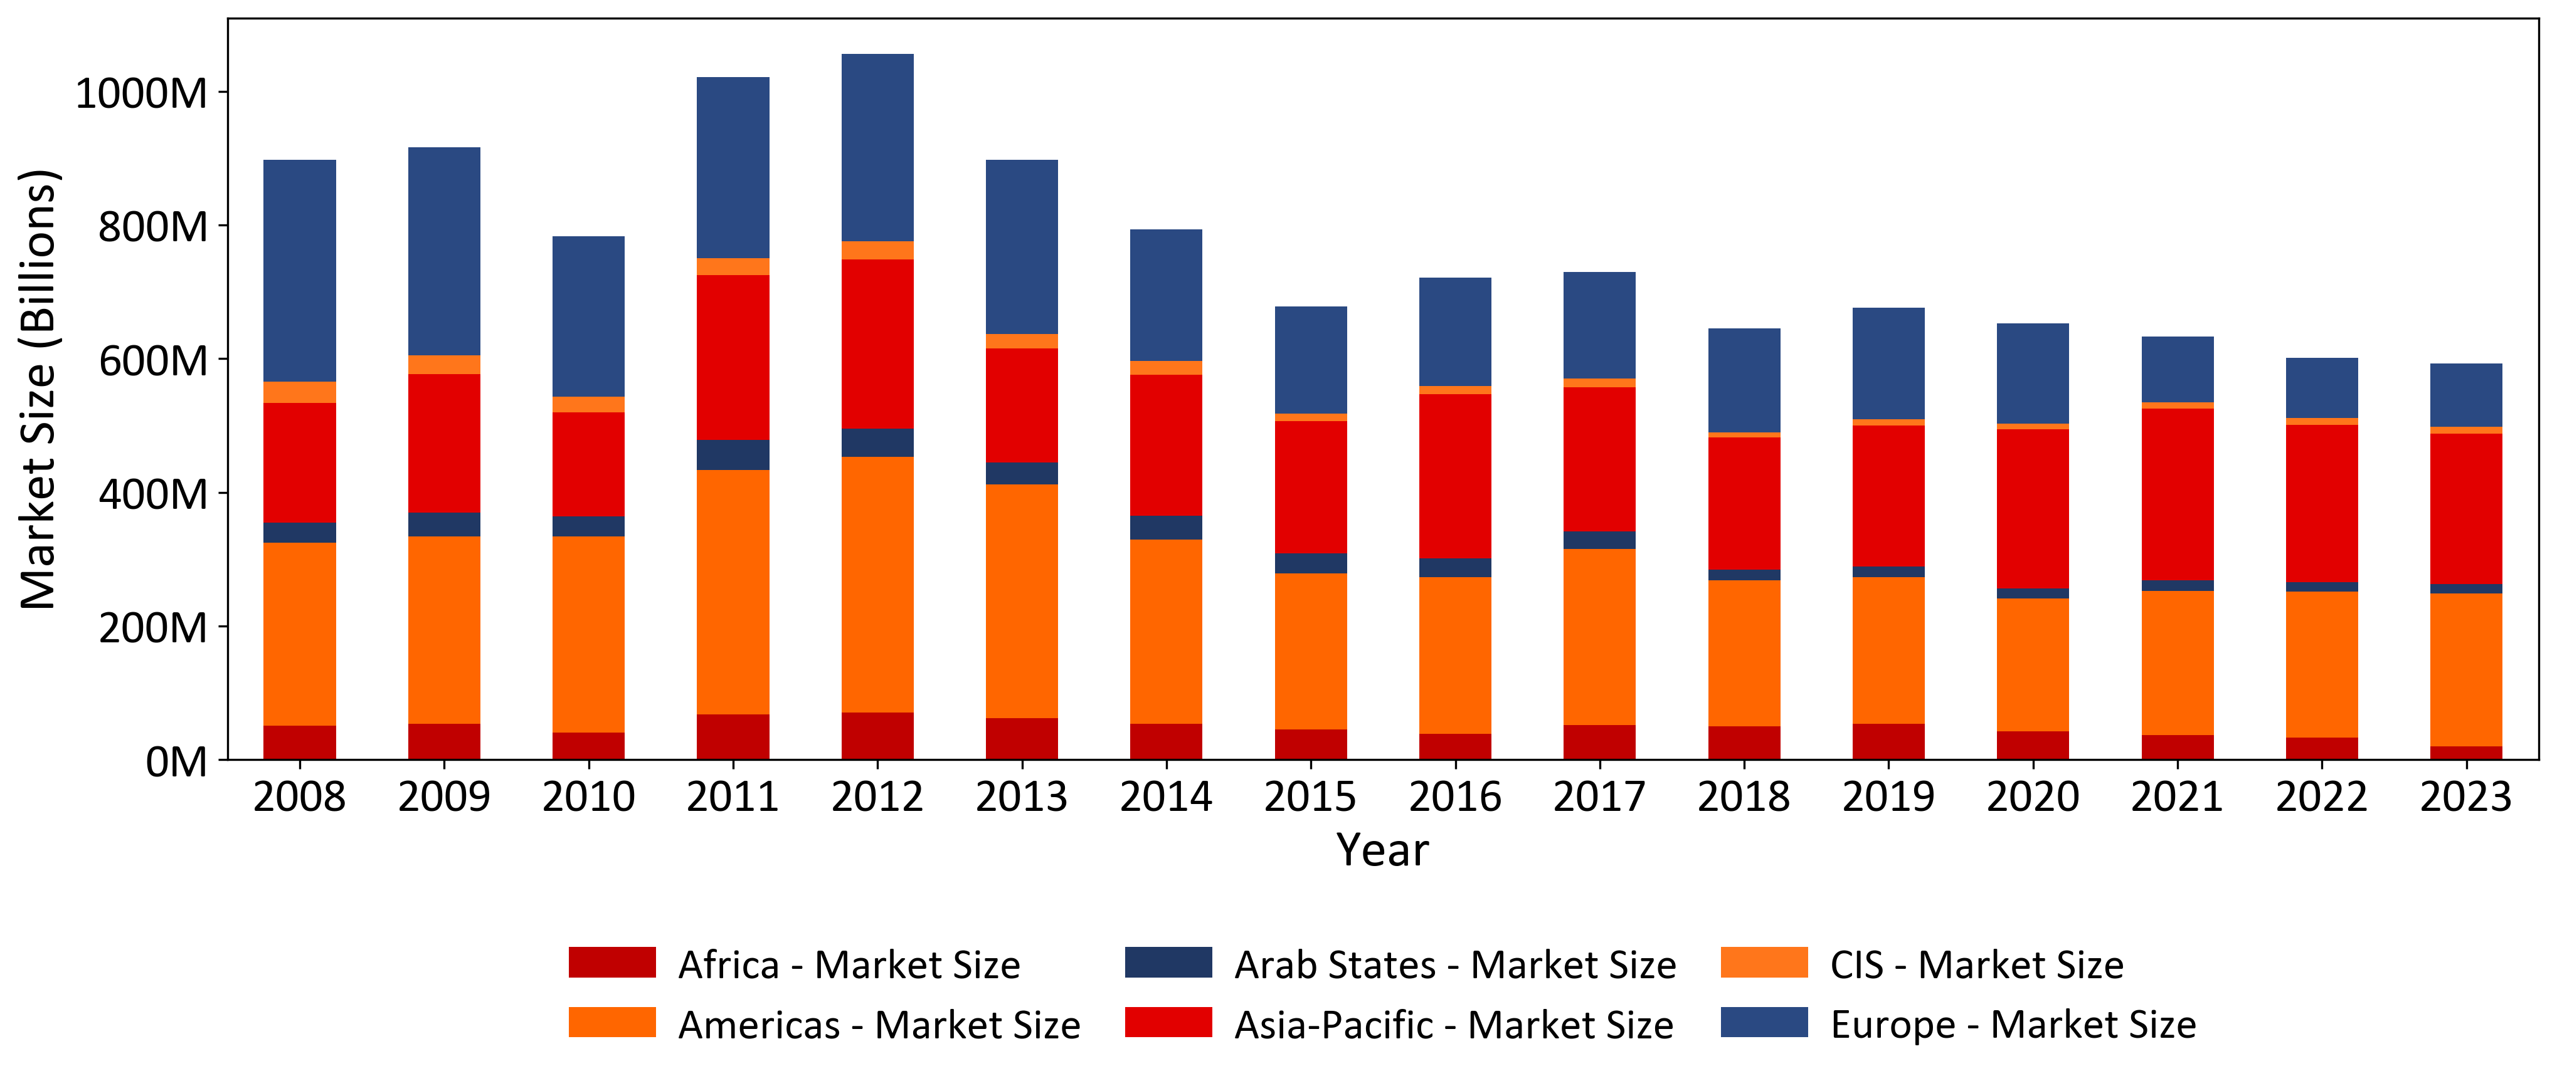
Mobile Voice Market Size Overview
Consistent with the global slide regional charts reflect a decline in mobile voice market since 2013
The decline was stronger in the higher income economies due to the shift to data and messengers
Asia was the only region, where mobile voice market still continued growing, which is partly explained by network coverage, catch up growth but also cultural preferences
Since 2012 mobile operators were actively changing their business models to retain revenues and margins with very different success, the overall EBITDA margins erosion was roughly 15%-20% on average (not the focus of this presentation)
Mobile Voice Market Size in Key Economies by Income Split
Mobile Voice Market Size in Key Economies by Regional Split
Source: ITU
10

Slide 10
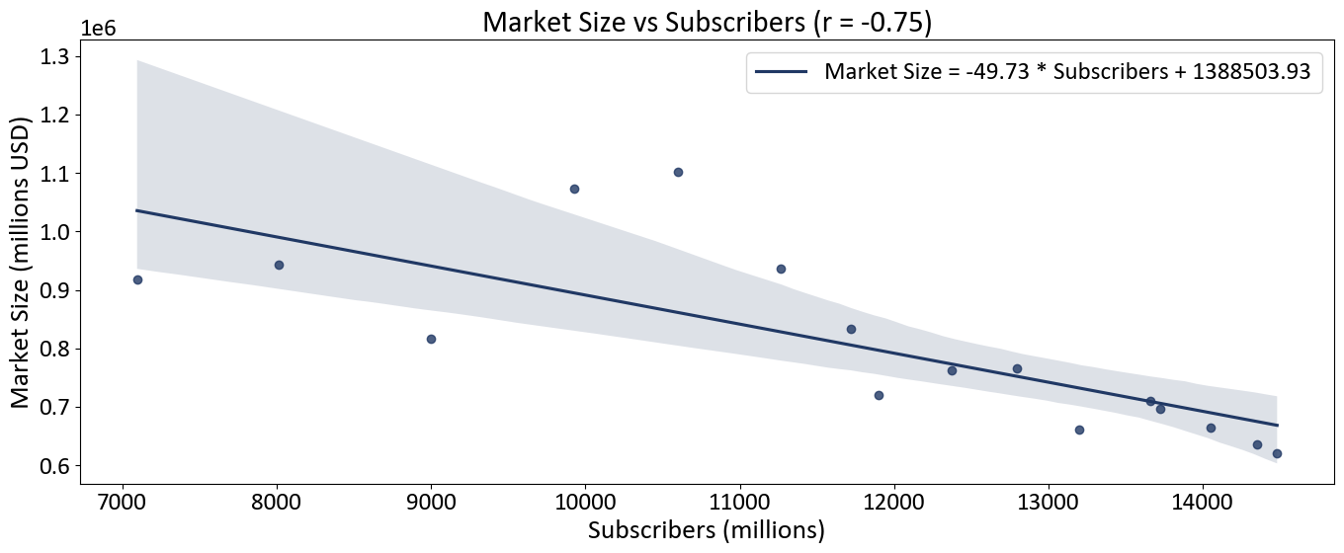
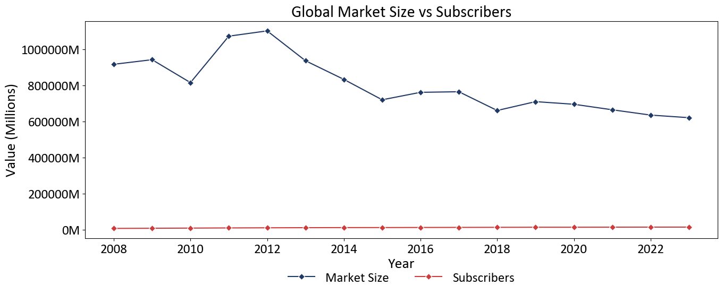
Growth Drivers: Subscribers
The growth in the number of subscribers was the key driver for the global mobile voice market since the start of the market in 1990s
However, the correlation for 2008 – 2023 was negative (0.75) with the key reasons being:
Most of the market growth happened in late 1990s -2008, which we don’t see in the available data
The mobile voice market was falling after 2012 explained by the shift to data and messengers with cheaper package-pricing for data traffic and no interconnection and landing fees
General preference to interact in writing compared to making voice calls
Mobile operators are seeking for new business models including the provision of more content and building of eco-systems, some still suggest taxing social network and messenger companies a traffic charge for consumer access to social media content
Global Mobile Voice Subscribers and Market Size Regression
Global Mobile Market Size and Subscriber Base Development
Note: correlation charts were produced manually in the preprocessing file because of their non-standard format
Source: ITU
6

Slide 11
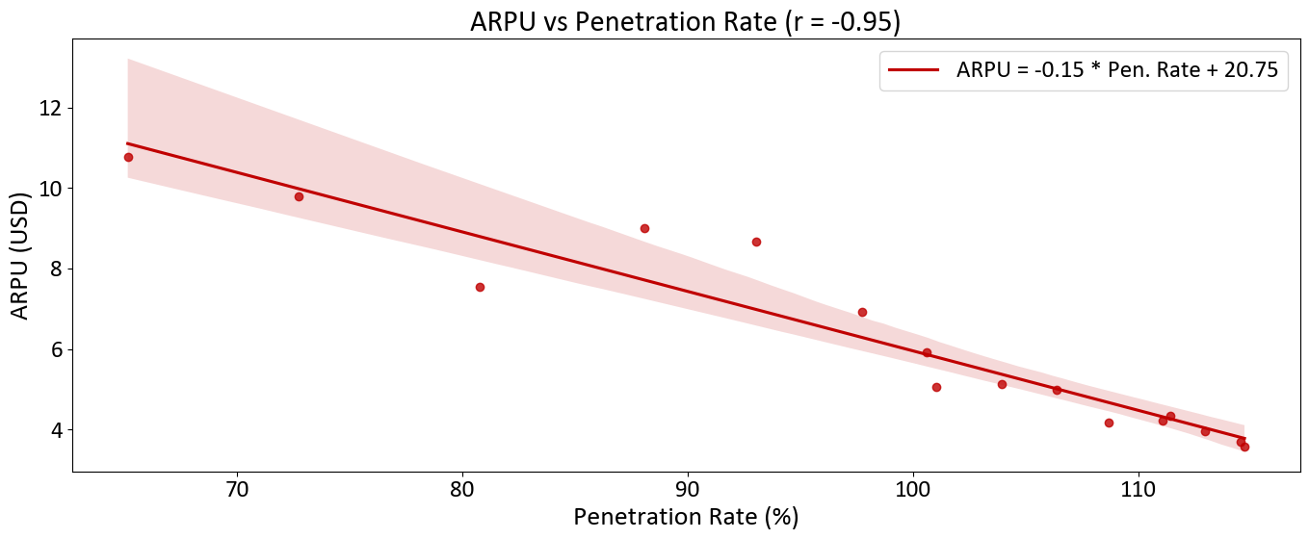
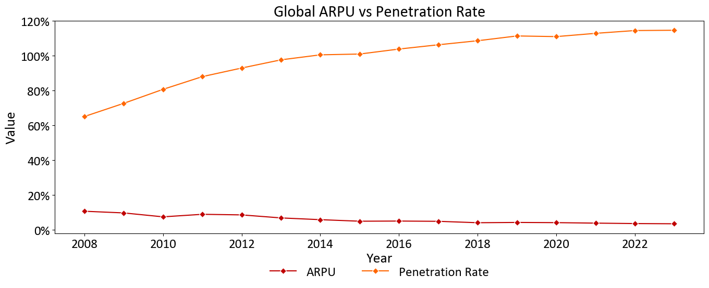
Growth Drivers: ARPU
Mobile voice ARPU decline over 2008-2023 was, unlike subscriber growth, the continuation of the trend
ARPU was falling a the technology was becoming cheaper (Moore’s law), economies of scale, transition to data traffic (VOLTE/VOIP) also in the emerging markets around 2008-2012, competition, and almost no government regulation, which is a strong advantage
One should note that penetration rate growth well beyond 100% accounts for the users having several numbers, e.g., private and business and a share of business mobile numbers
Correlation of ARPU decline and penetration rate growth was almost perfect - minus (0.95%)
Global Mobile Voice Penetration and ARPU
Global Mobile ARPU and Penetration Rate Development
Note: correlation charts were produced manually in the preprocessing file because of their non-standard format
Source: ITU
7

Slide 12
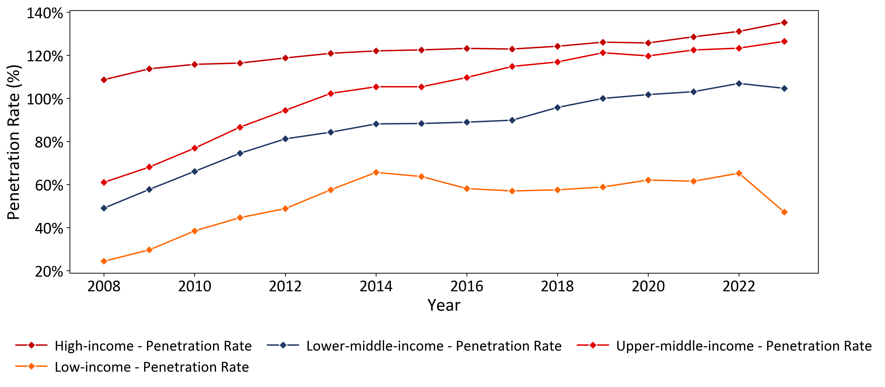
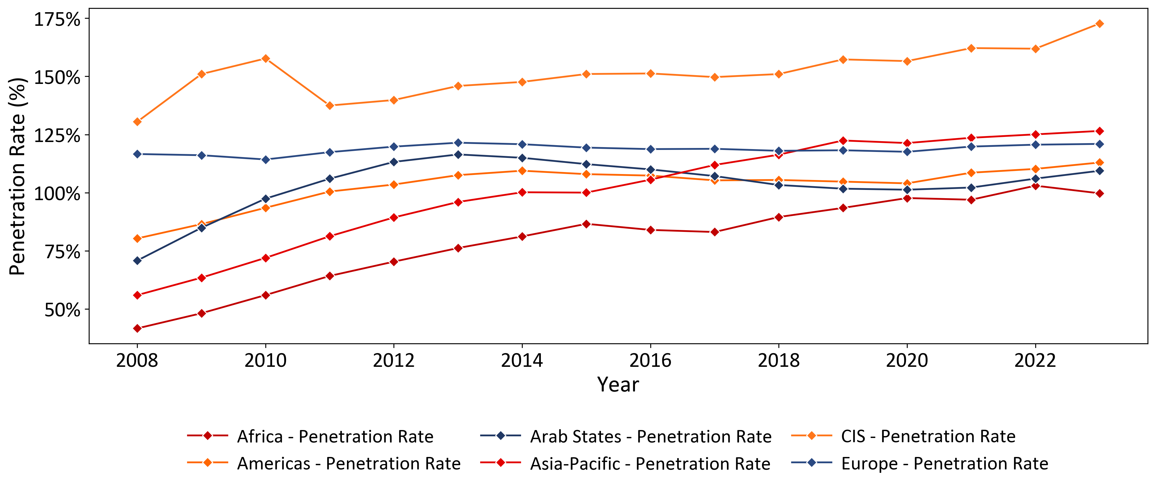
Mobile Voice Communications Penetration Rates Development
Mobile voice penetration rates in higher income regions were above the world average drive by business segment and IOT, while this is still a less significant factor in lower income economies
While the highest penetration rates in 2008-2023 in mobile voice market was in the CIS region the highest growth was in Asia and Africa
High CIS penetration rates are explained by low ARPU, popularity of corporate phones and frequent change of tariffs and operators
Mobile Voice Penetration Rates in Key Economies by Income Split
Mobile Voice Penetration Rates in Key Economies by Regional Split
Source: ITU
8

Slide 13
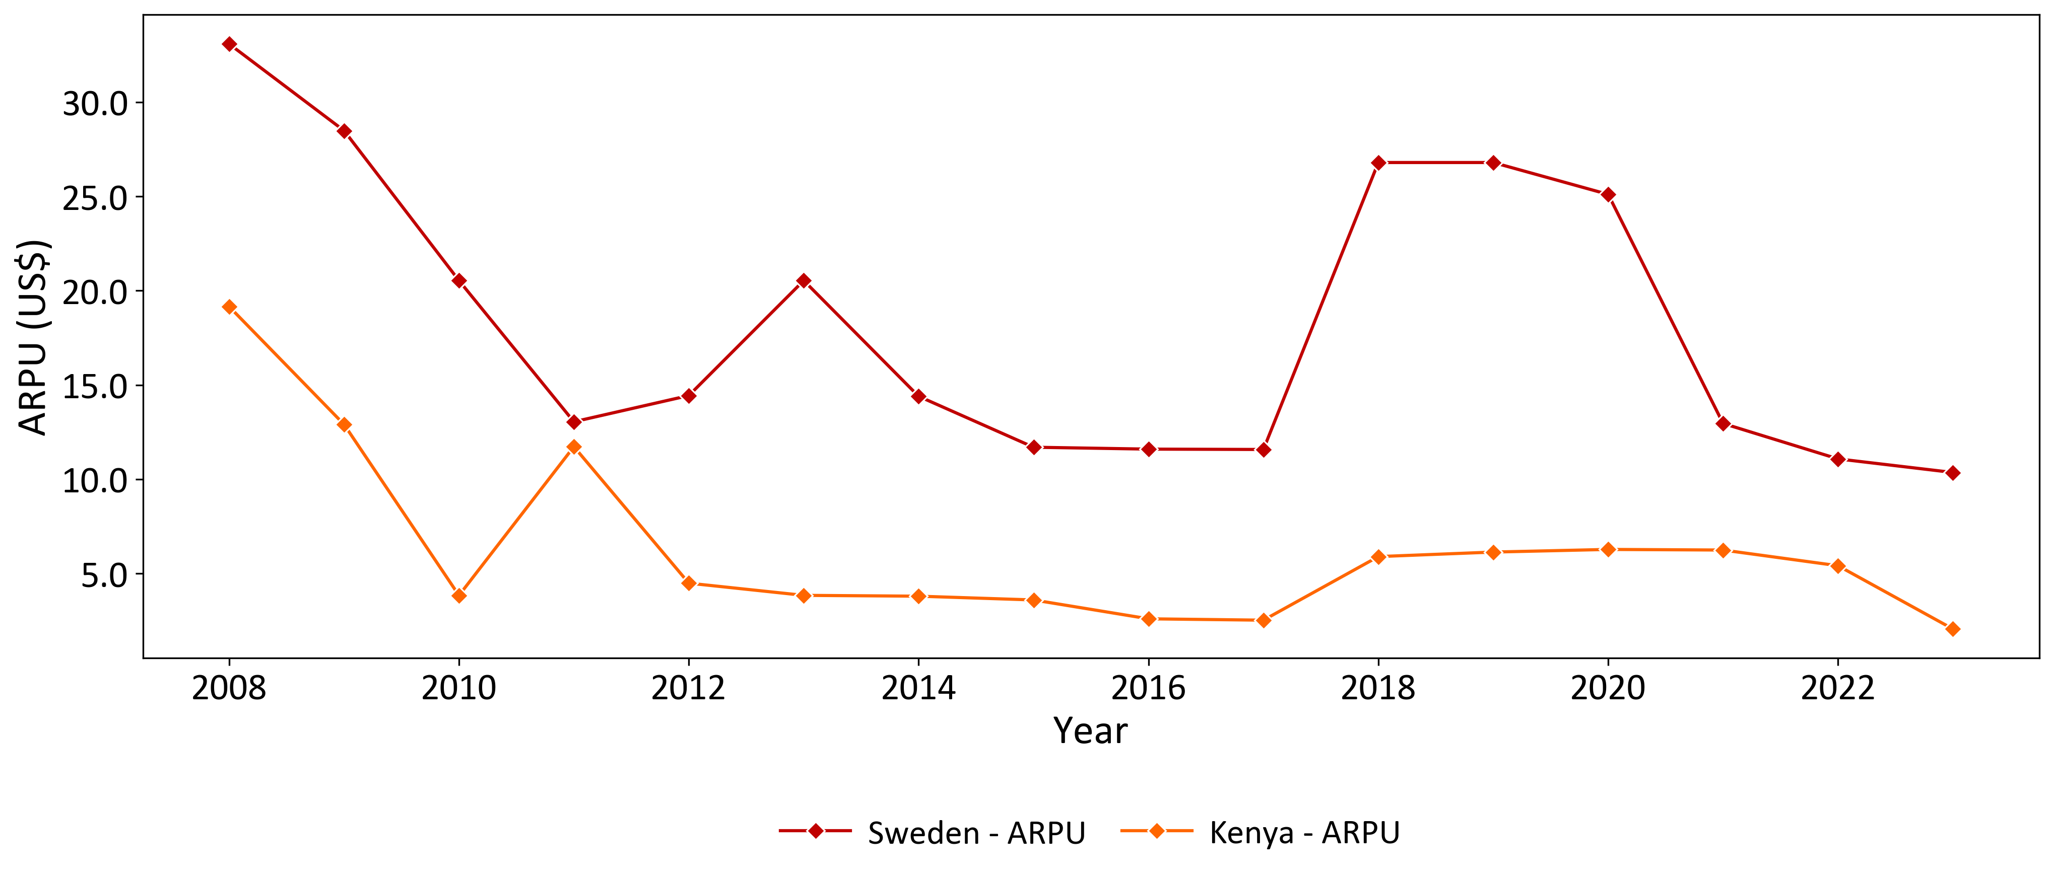
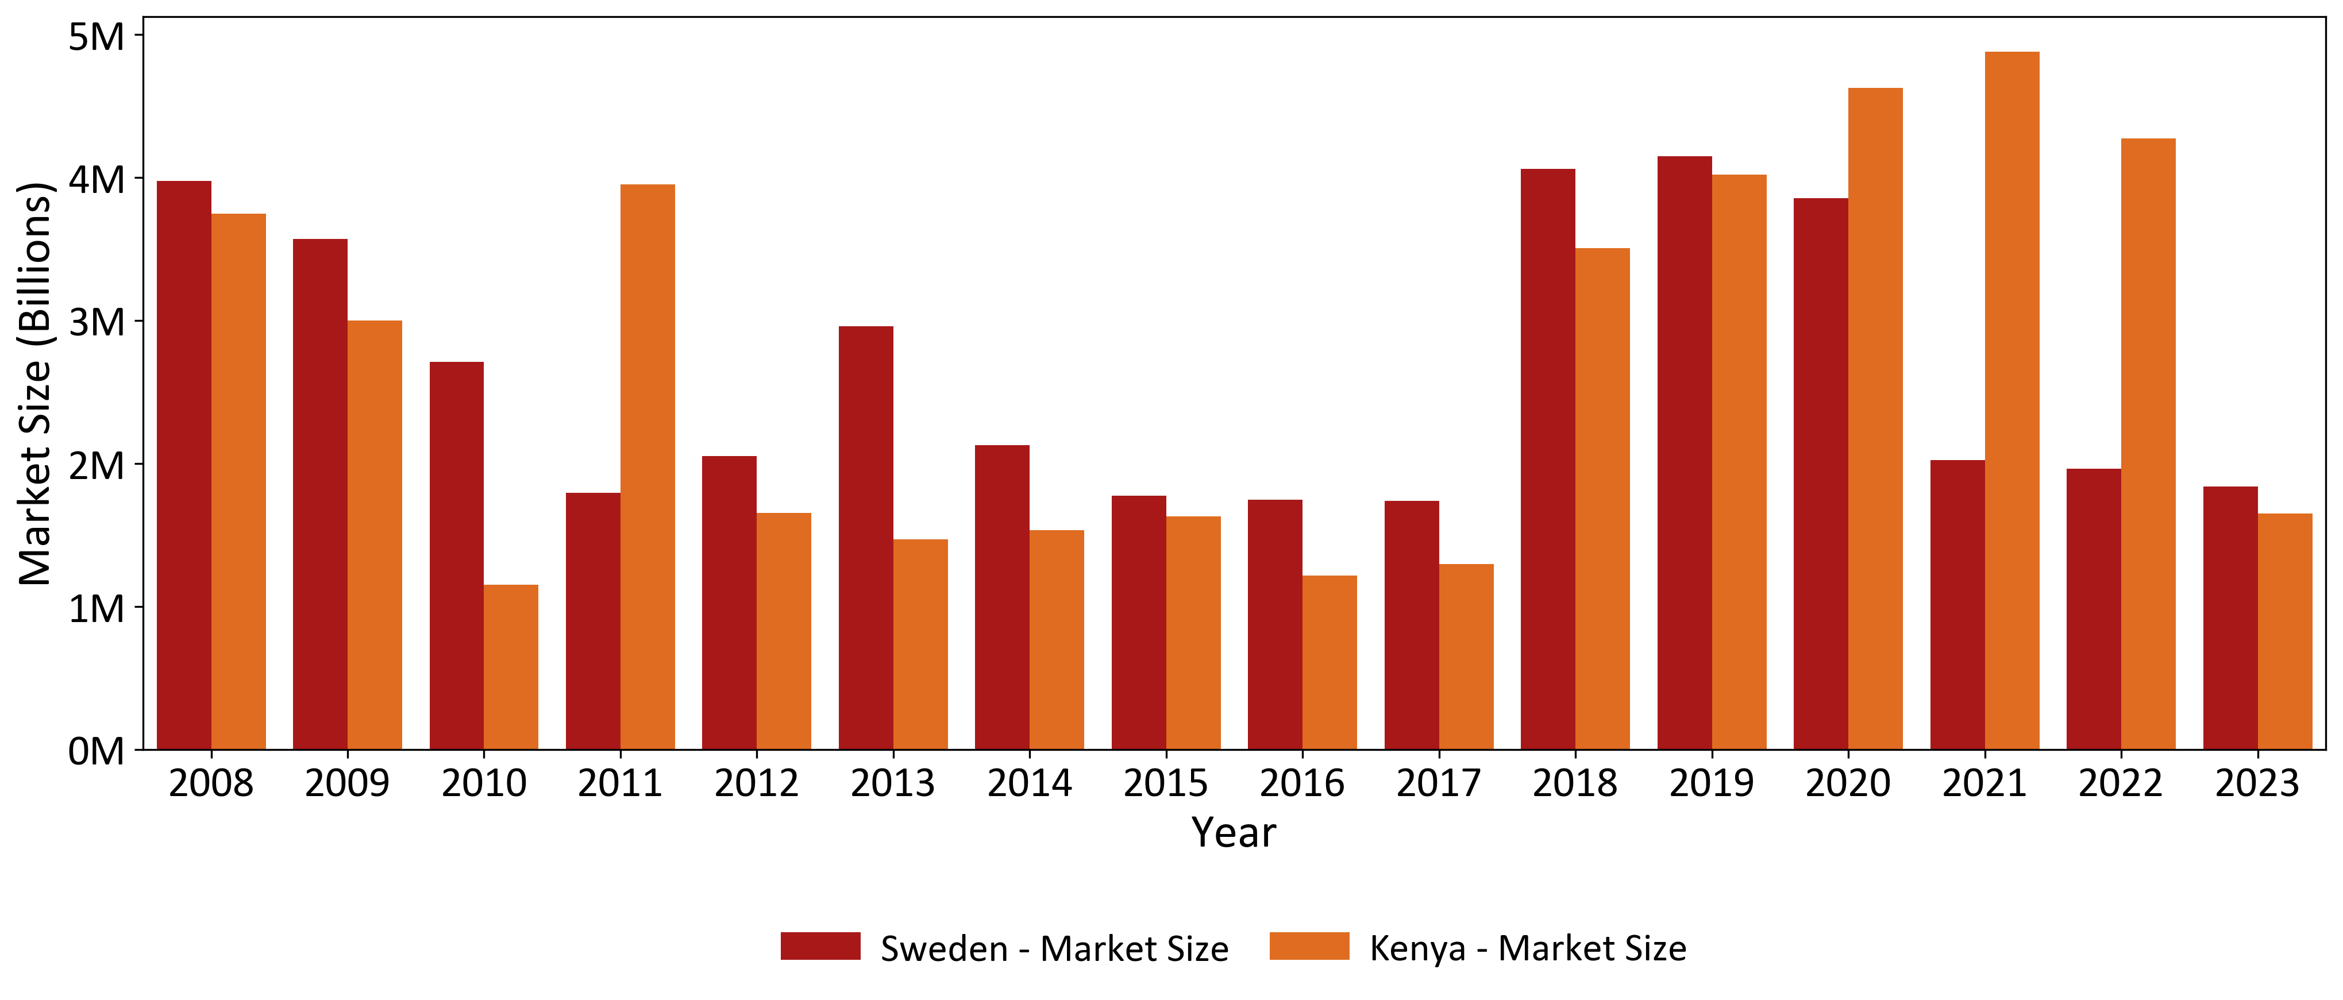
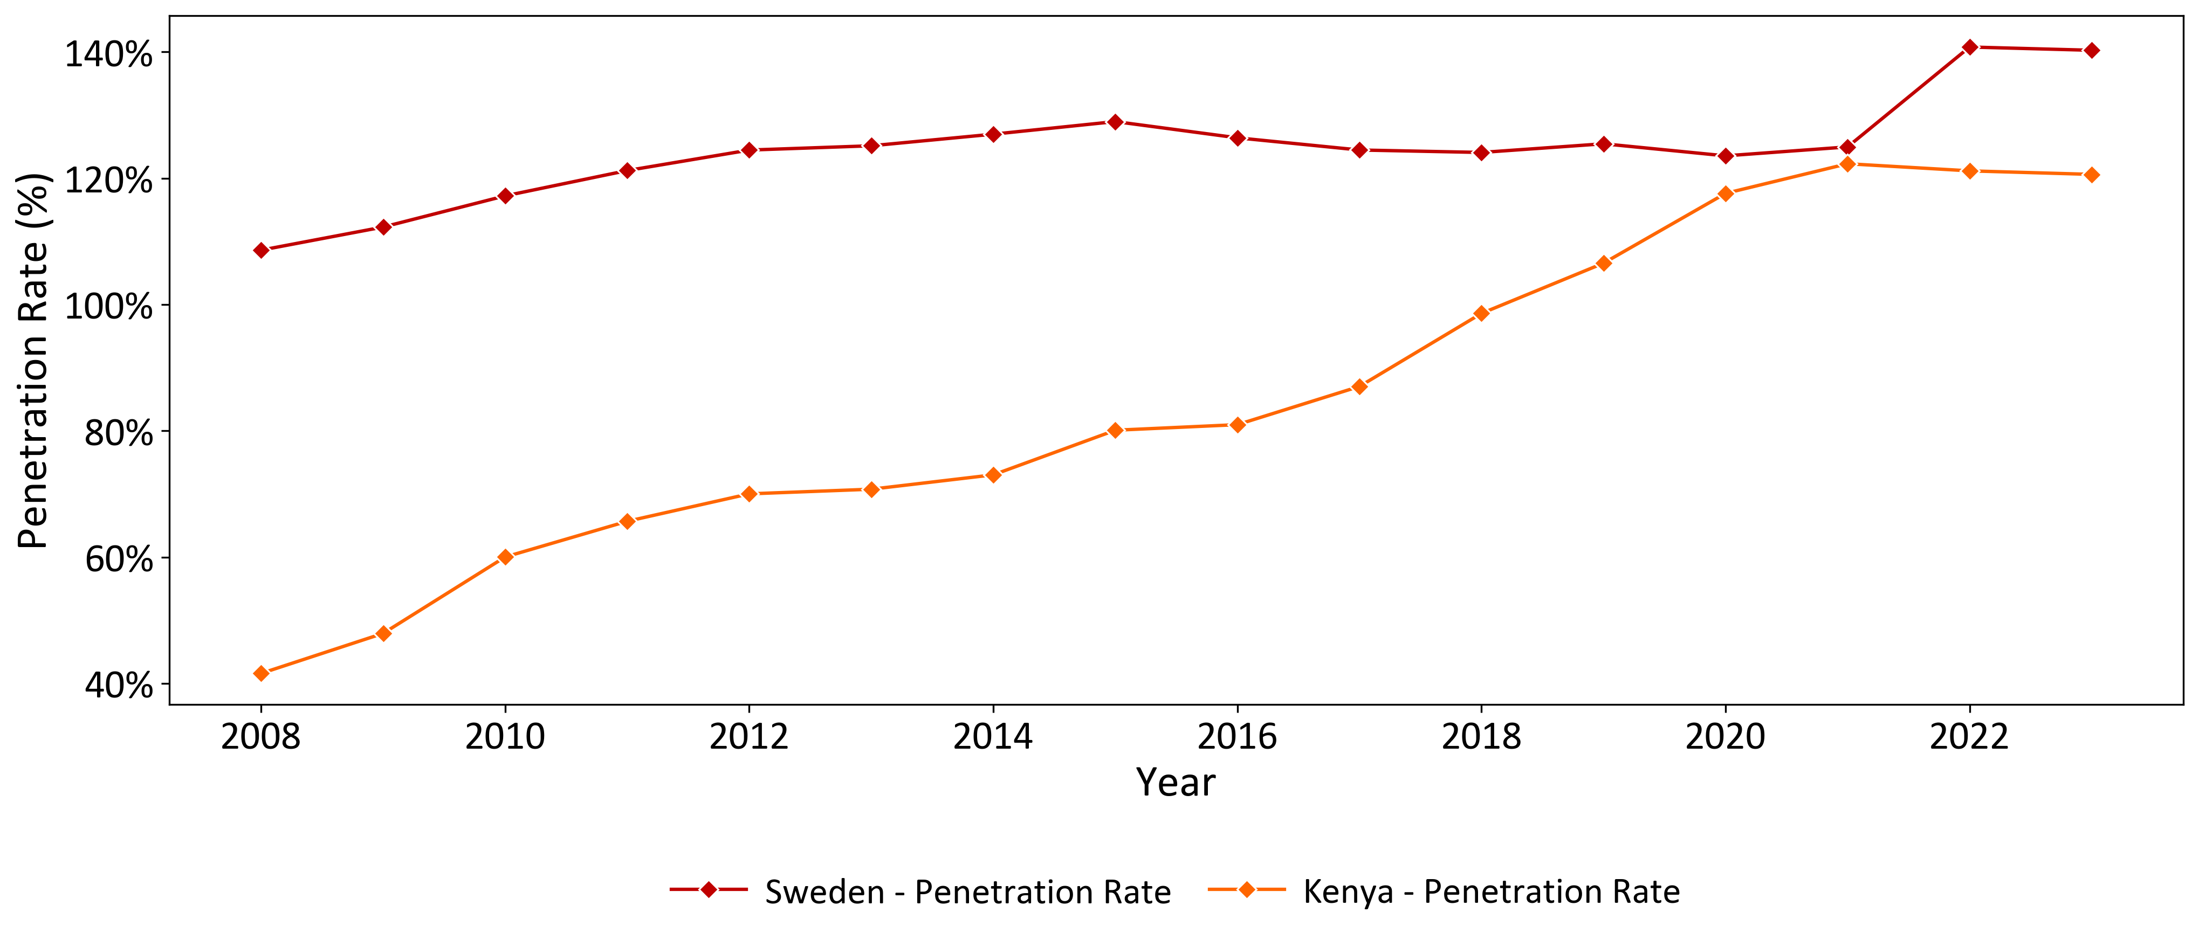
Selected Developed vs. Emerging Comparison – Kenya : Sweden
Except for high/low income divide and earlier market saturation Kenya and Sweden are consistent with the global mobile voice trends
Despite a ~5.x difference in population the mobile voice market size in Kenya and Sweden is almost the same
ARPU reflects a reducing gap between a developed and an emerging market
Mobile voice market continued falling except around Covid-time in Kenya (there was no strict lockdown in Sweden)
The shift to data started around 2008 or even earlier for both Kenya and Sweden
Penetration rate in Kenya reached 100% only in 2019, Sweden’s ARPU was stagnant over the period
ARPU Development
Market Size Development
Penetration Rate
Source: ITU
14

Slide 14
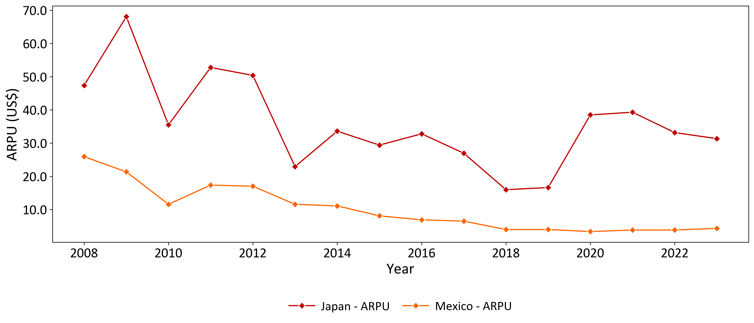
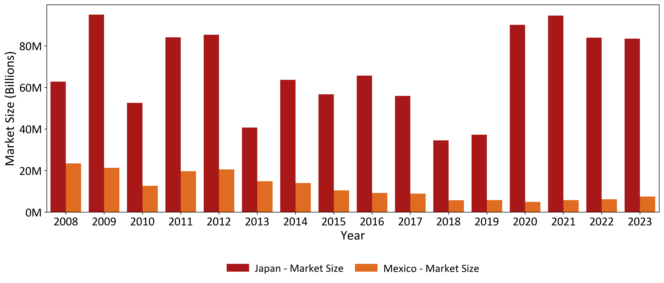
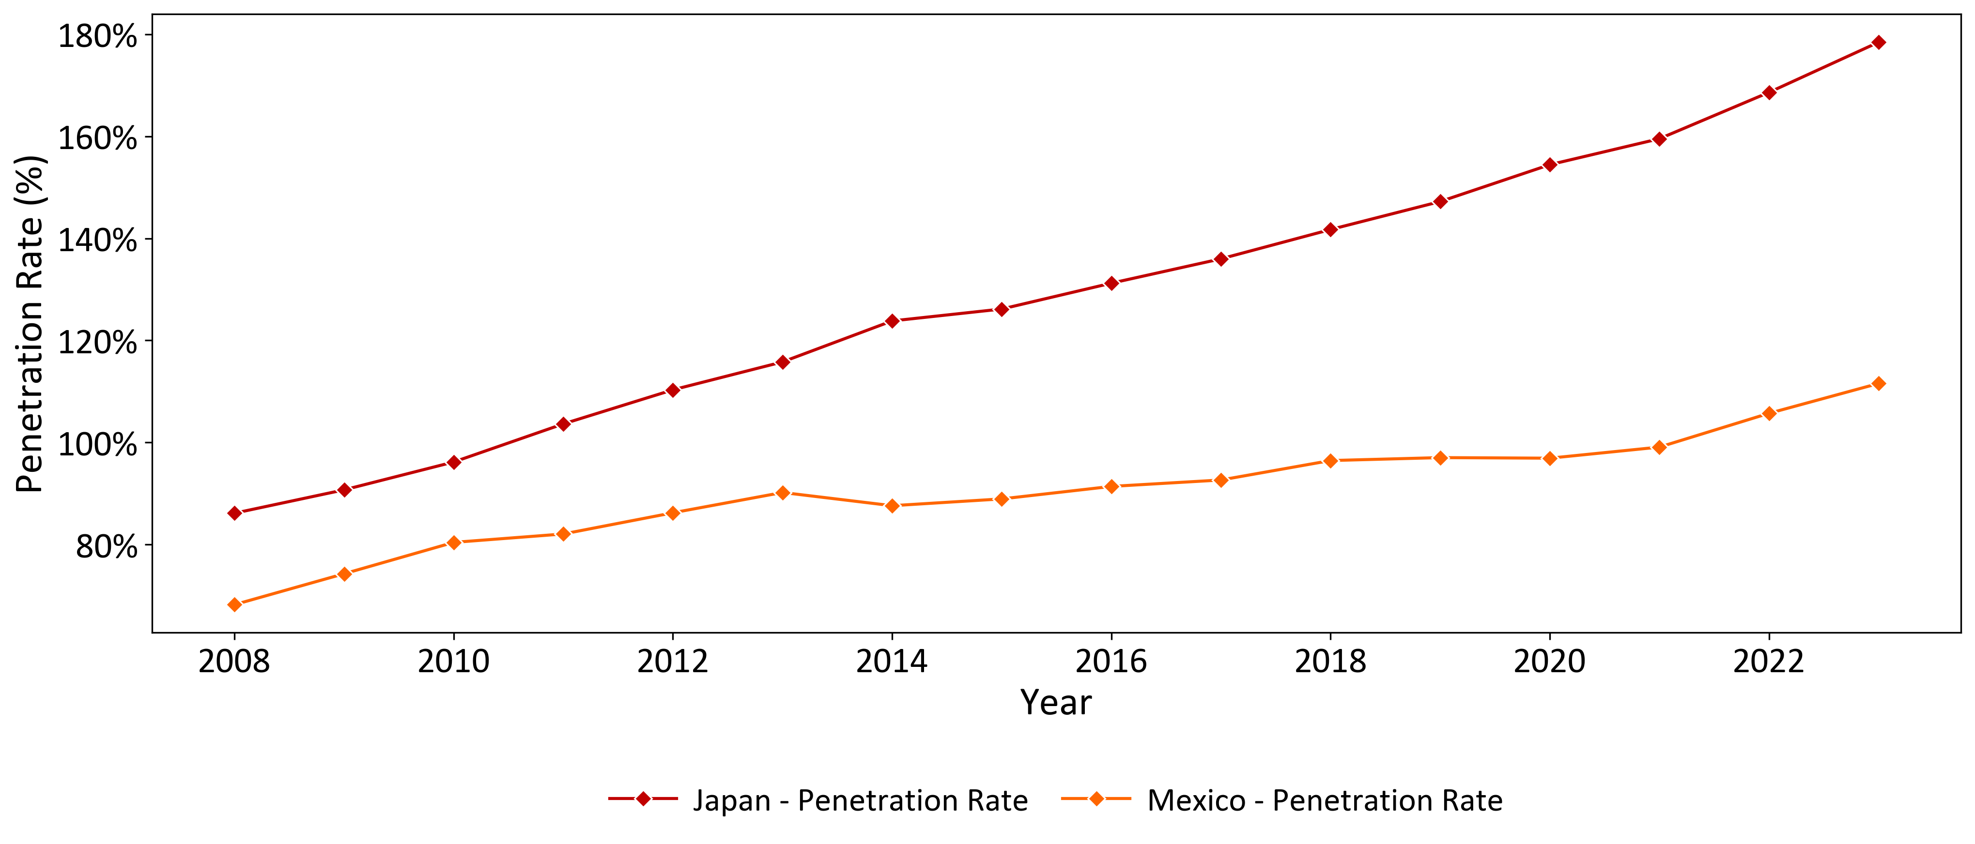
Selected Developed vs. Emerging Comparison – Japan : Mexico
Mexico fits into the general mobile voice pattern, while Japan reflects stronger cultural preference for voice communication
Japans market is larger than Mexico’s by both population and market but the decline in mobile voice after 2012 is still visible (except Covid)
ARPU development in Japan appears less consistent, the drop in 2008-2010 was probably due to subprime crisis and lower business activities but otherwise it is probably a cultural feature of Japan to have more voice communication
Penetration rate growth in Japan is outstanding even for a developed market and may be an indicator of the future for the rest of the world
Penetration rate in Japan reflect the culture of separate profile for business and private purposes, which seams both reasonable and ethical
ARPU Development
Market Size Development
Penetration Rate
Source: ITU
15

Slide 15
Unusual Findings
Despite the common expectation for the analyzed market phase the growth of subscribers leads to the decline of mobile voice market, however, it means that revenues shift to data and media market segments
Kenya’s population is roughly 5.x larger than Sweden’s, however, the market sizes are very similar
COVID-19 affected countries in quite different ways. In progressive Sweden ARPU increased dramatically because there was no real lockdown at all; yet, communications substituted most of personal contacts
Some markets do not follow the trends. For example mobile penetration rates in Japan, the model country of the future, continue growing to 180% due to cultural preferences for voice communication and ethics, a separate phone for business purposes, not to mention IOT
4

Slide 16

Key Findings & Recommendations
Key Findings
Peak of the global mobile voice services in 2012, then decline in all regions except Asia
Subscriber growth no longer drives revenue growth (negative correlation with market size)
ARPU drop due to cheaper technology, competition, and shift to messengers (r ≈ -0.95 with penetration rate)
High penetration (>100%) in many countries driven by multiple SIM cards and corporate contracts
Developed markets reached saturation earlier and lost revenue faster; emerging markets followed the same trend later
Recommendations
Targeted tariffs in high-penetration countries to increase ARPU
Personalized pricing and upsell in countries with high saturation using big data analytics to sell additional packages (speed, content, services) without increasing the number of SIM cards
Promoting own ecosystems to fight back against social networks and messengers as a mix of content and value added-services - streaming video, music, cloud storage, gaming services etc. to increase ARPU at a moderate CapEx
Expansion of premium services, IoT solutions, AI-based services
Expansion of corporate services, M2M communications, smart devices, eSIM, and industry IoT platforms (logistics, agritech, energy etc.)
Growth potential in about 2 dozen countries with low penetration (50%-70%) and political risks often with development banks
4

Slide 17
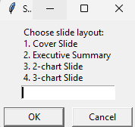
Project Snapshot
The Project pre-processes csv mobile voice data from ITU website and automates making charts, slides and presentations
The Project menu launched from ITU_Main, supporting files include ITU_Utilities , Create_Charts
Menu:
0. Load dataframe – in the beginning
Menu:
0. Load dataframe
1. Create new charts
2. Read charts
3. Prepare slides
4. Compile slides into presentations
5. Delete charts and slides
6. Exit
Choose action: 0
✅ DataFrame loaded and formatted.
Choose action: 1
Available Indicators:
1. ARPU
2. Population
3. Subscribers
4. Market Size
5. Penetration Rate
Select indicator(s) (e.g., '1,3-4’):
Choose action: 2
Select files (e.g., 1,3,5-7):
Choose action: 3
Choose action: 4
Select an option:
1. Create a new presentation from selected slides.
2. Insert slide(s) into an existing presentation.
Enter option number (1 or 2):
1. Available Slide Files:
Enter slide numbers in desired order (e.g., 1,2,4-5):
2. Available Presentations:
Select a presentation number to insert into:
Available Slide Files:
Enter slide numbers to insert (e.g., 1,3-4):
Presentation has 13 slides.
Insert after which slide number(s)? (e.g., 2,4):
✅ Presentation saved as Presentation5.pptx in 'Presentations' folder.
Choose action: 5
Which folder would you like to manage?
1. Charts
2. Slides
3. Presentations
Enter your choice: 1
Enter file numbers to delete (e.g., 1,3-4):
Enter your choice: 2
Enter file numbers to delete (e.g., 1,3-4):
Enter your choice: 3
Files in Presentations:
1. ITU Mobile Telecoms by Pandas Presentation.pptx
2. ITU Mobile Telecoms by Pandas Presentation2.pptx
3. Presentation1.pptx
4. Presentation4.pptx
5. Presentation_1.pptx
Presentation management options:
1. Delete Slides from Presentation
2. Delete Entire Presentation
Enter your choice (1-3):
2

